Slide 1

Programming Fundamentals & Higher Order Programming

Slide 2
Programming Paradigms
Imperative
Procedural
Functional
Object-oriented
Logic
Styles of coding
Notes:
Programming Paradigms are Styles of coding. Using different paradigms forces you to think differently, to approach problems differently. It’s as if they’re different tools, and you must choose one to solve a problem. There are many programming paradigms. I’ll be talking about these 5.

Slide 3
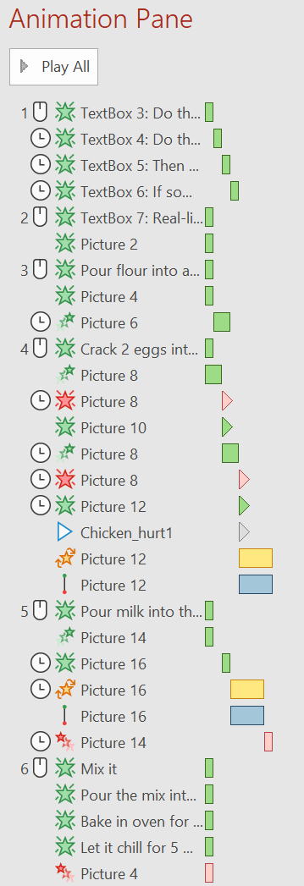











Imperative Programming
if (y > 1) x += 5;
Do this
If something, then do this
int y = x / 3;
Do this
x *= 2;
Then do this
int x = 5;
Real-life Example: Baking a cake
Pour flour into a bowl
Crack 2 eggs into the bowl
Pour milk into the bowl
Mix it
Pour the mix into a mold
Bake in oven for 30 minutes
Let it chill for 5 minutes
Notes:
You are a programmer. You want your computer to do stuff. With imperative programming, you make the computer do stuff by explicitly telling it each and every instruction. To make a cake in reak-life, you may create a step-by-step list with the following:

Slide 4
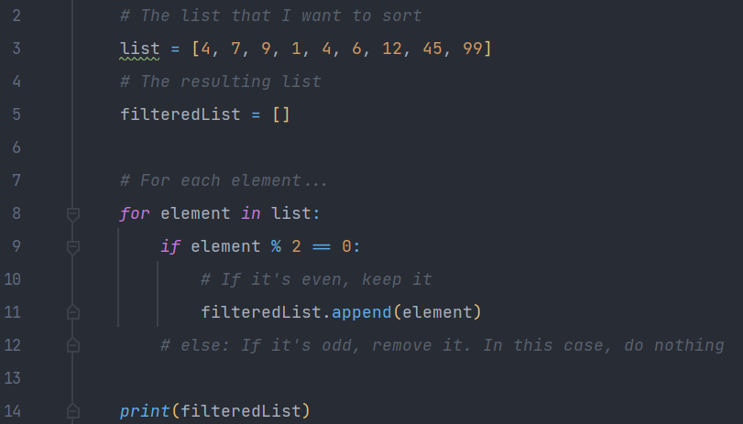
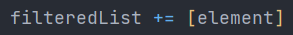
Imperative Programming
Code example: Filtering out the odd numbers in a list (in Python, since its syntax is great for reading and writing)
If the first element is an even number, keep it
If the first element is an odd number, remove it
If the second element is an even number, keep it
…
or
For each element, if it’s even, keep it
For each element, if it’s odd, remove it

Slide 5
procedural Programming
Extends Imperative Programming
Real-life Example: Baking a cake (Imperative)
Pour flour into a bowl
Crack 2 eggs into the bowl
Pour milk into the bowl
Mix it
Pour the mix into a mold
Bake in oven for 30 minutes
Let it chill for 5 minutes
Procedure: Pour ingredients
Procedure: Mix and transfer to mold
Procedure: Bake and let chill
Real-life Example: Baking a cake (Procedural)
Real-life Example: Baking many muffins (Procedural)
Pour ingredients
Mix and transfer to mold
Bake and let chill
Pour ingredients x3
Mix and transfer to mold
Add fruits
Bake and let chill
To write the algorithm, we don’t need to know how ‘Pour ingredients’ works. We only need to know what it does. This is called “Procedural Abstraction”
Notes:
Procedural programming is an extension of imperative programming. In procedural programming, we split step-by-step instructions into procedures. This lets us be more organized when specifying an algorithm (or a recipe), and it lets us re-use procedures.

Slide 6
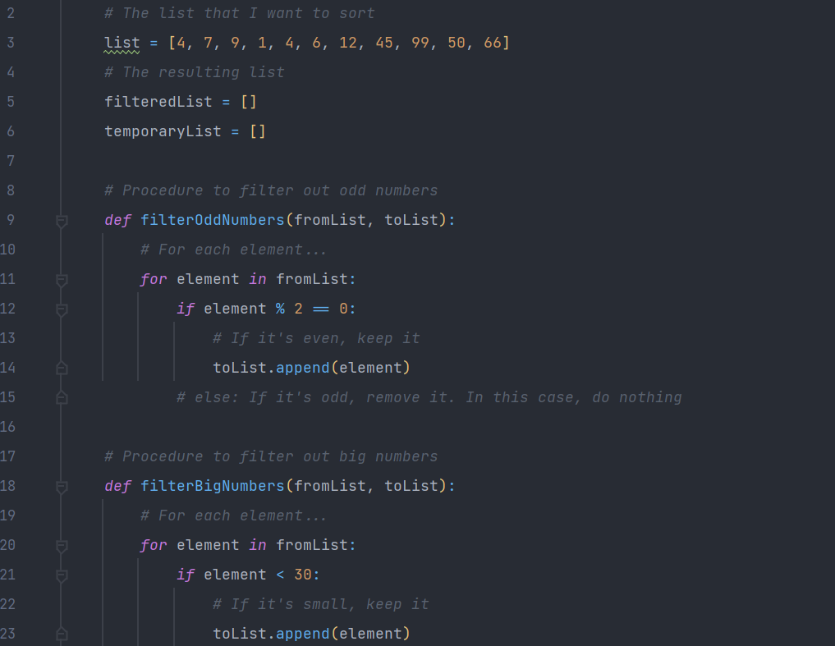
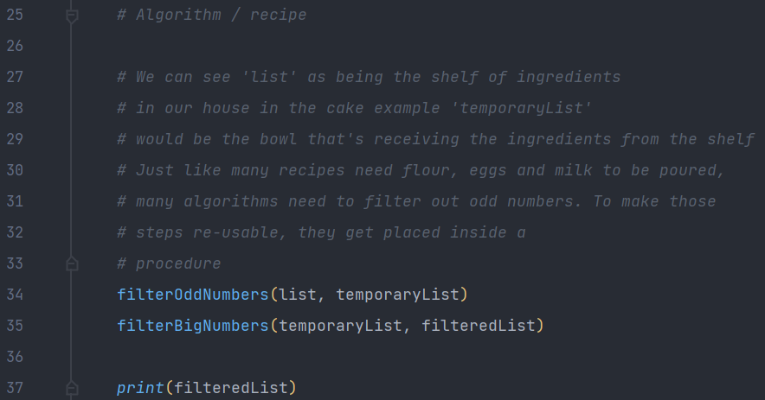
procedural Programming
Code example: Filtering out the odd and big numbers in a list (in Python)
procedure
procedure
procedure
If I wasn’t the one writing the procedure definitions, I would still be able to write the algorithm thanks to Procedural Abstraction.
procedure

Slide 7
functional Programming
First-class citizens:
Imperative instruction
If, else
For, while
First-class citizens:
Functions
How?
Second-class:
- Functions
Second-class:
- If, else
Higher Order Programming
Notes:
Functional Programming is a paradigm you’ve seen and probably used before, but not to it’s full potential. In a language whose only paradigm is functional, there are no variable declarations. There are no fors and whiles. Higher Order Programming is a consequence of Functional Programming

Slide 8
functional Programming
Topic9_Python/Examples/ProgrammingParadigms/FunctionalExample.py
Coding time!

Slide 9
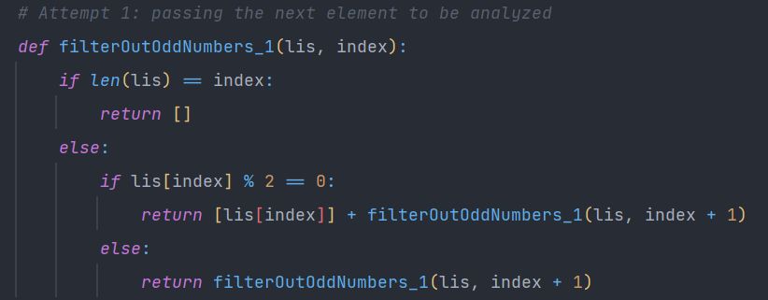
functional Programming
Code example: Filtering out the odd and big numbers in a list (in Python)
lis = [2,3,4,6,7], index = 0
len(lis) = 5, lis[0] = 2
1st iteration: return [2] + filter([2,3,4,6,7], 1)
lis = [2,3,4,6,7], index = 1
len(lis) = 5, lis[1] = 3
2nd iteration: return [2] + filter([2,3,4,6,7], 2)
lis = [2,3,4,6,7], index = 2
len(lis) = 5, lis[2] = 4
3rd iteration: return [2] + [4] + filter([2,3,4,6,7], 3)
lis = [2,3,4,6,7], index = 3
len(lis) = 5, lis[3] = 6
4th iteration: return [2] + [4] + [6] + filter([2,3,4,6,7], 4)
lis = [2,3,4,6,7], index = 4
len(lis) = 5, lis[4] = 7
5th iteration: return [2] + [4] + [6] + filter([2,3,4,6,7], 5)
lis = [2,3,4,6,7], index = 5
len(lis) = 5, lis[5] = out of bounds
6th iteration: return [2] + [4] + [6] + []
[2, 4, 6]

Slide 10
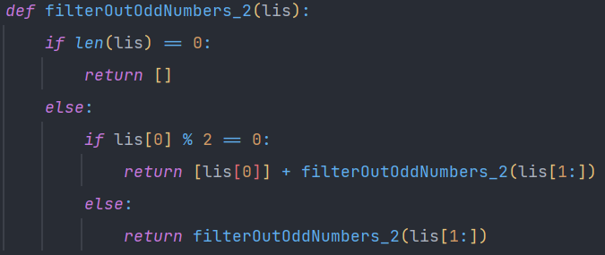
functional Programming
Code example: Filtering out the odd and big numbers in a list (in Python)
lis = [2,3,4,6,7]
len(lis) = 5 lis[0] = 2
1st iteration: return [2] + filter([3,4,6,7])
lis = [3,4,6,7]
len(lis) = 4 lis[0] = 3
0 1 2 3 4
2nd iteration: return [2] + filter([4,6,7])
[2,3,4,6,7]
lis = [4,6,7]
len(lis) = 3 lis[0] = 3
3rd iteration: return [2] + [4] + filter([6,7])
lis = [6,7]
len(lis) = 2 lis[0] = 6
4th iteration: return [2] + [4] + [6] + filter([7])
lis = [7]
len(lis) = 1 lis[0] = 7
5th iteration: return [2] + [4] + [6] + filter([])
lis = []
len(lis) = 0 lis[0] = out of bounds
6th iteration: return [2] + [4] + [6] + []
[2, 4, 6]

Slide 11


exercises
Topic9_Python/Exercises/ProgrammingParadigms
Exercise 1 and 2. If you quickly solved them, solve Exercise 3 (warning: it’s hard!)

Slide 12
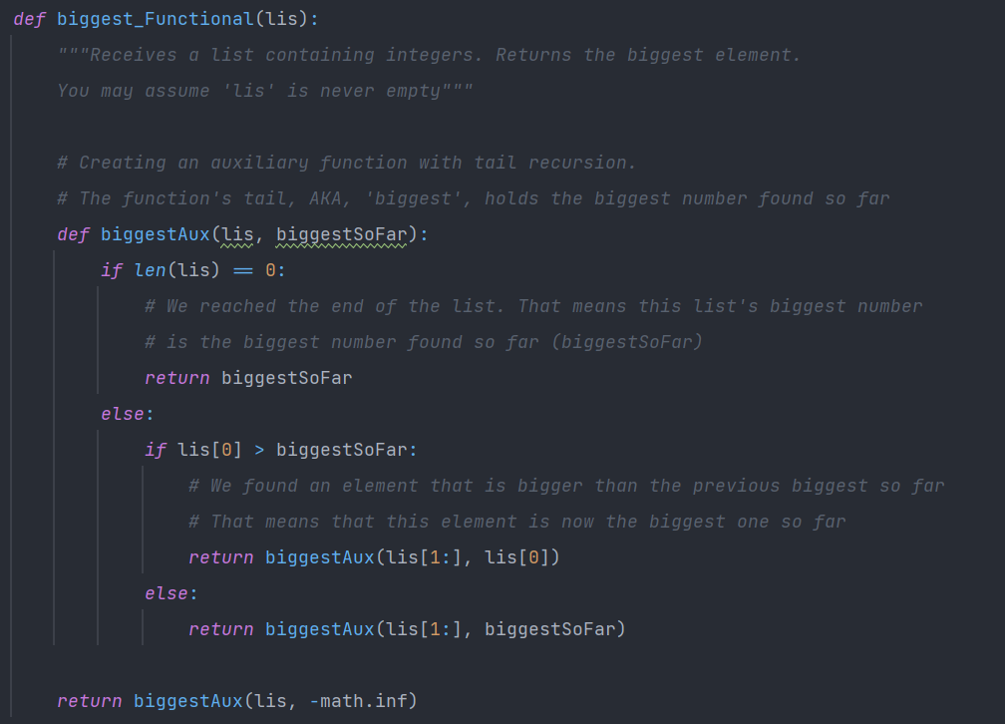
functional Programming
Tail recursion
Code example (exercise 3): Getting the biggest number in a list (in Python)
lis = [4,6,5,100,75]
1st recursive call: return biggestAux([4,6,5,100,75], -∞)
lis = [4,6,5,100,75]
biggestSoFar = -∞ lis[0] = 4
1st inner recursive call: return biggestAux([6,5,100,75], 4)
lis = [6,5,100,75]
biggestSoFar = 4 lis[0] = 6
2nd inner recursive call: return biggestAux([5,100,75], 6)
lis = [5,100,75]
biggestSoFar = 6 lis[0] = 5
3rd inner recursive call: return biggestAux([100,75], 6)
lis = [100,75]
biggestSoFar = 6 lis[0] = 100
4th inner recursive call: return biggestAux([75], 100)
lis = [75]
biggestSoFar = 100 lis[0] = 75
5th inner recursive call: return biggestAux([], 100)
lis = []
biggestSoFar = 100 lis[0] = out of bounds
6th inner recursive call: return 100
Notes:
To solve exercise 3, we need to employ a Functional Programming strategy called “Tail Recursion”. Tail Recursion is used when we need the recursive calls to memorize some useful information. Recursion can be used to iterate over a list. But if we want to figure out what the biggest number is, we need to keep track of the biggest number found so far, much like we do in Imperative Programming. Nothing’s preventing us from creating an auxiliary function that has an extra argument: the biggest number found so far. This extra argument is called the “tail”

Slide 13
functional Programming
vs
imperative Programming
So far, Imperative seems easier.
Functional requires us to think from the end (we start with the bottom case, ex: empty list).
However, some problems are extremely difficult to solve using Imperative only.
These Paradigms are 2 distinct tools. Some are better suited for some problems that the other is not.

Slide 14
functional Programming
Is good for: divide and conquer algorithms
Code example: Merge sort algorithm: https://www.programiz.com/dsa/merge-sort
The Merge Sort algorithm combines Imperative and Functional
We’ll see how it works in detail on the Algorithms Topic. In short:
Base idea: Combining 2 sorted lists into a single sorted list is very easy:
1
2
5
8
9
10
11
14
5
8
9
11
1
2
10
14
List 1
List 2
Combined lists

Slide 15
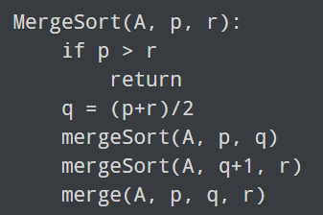
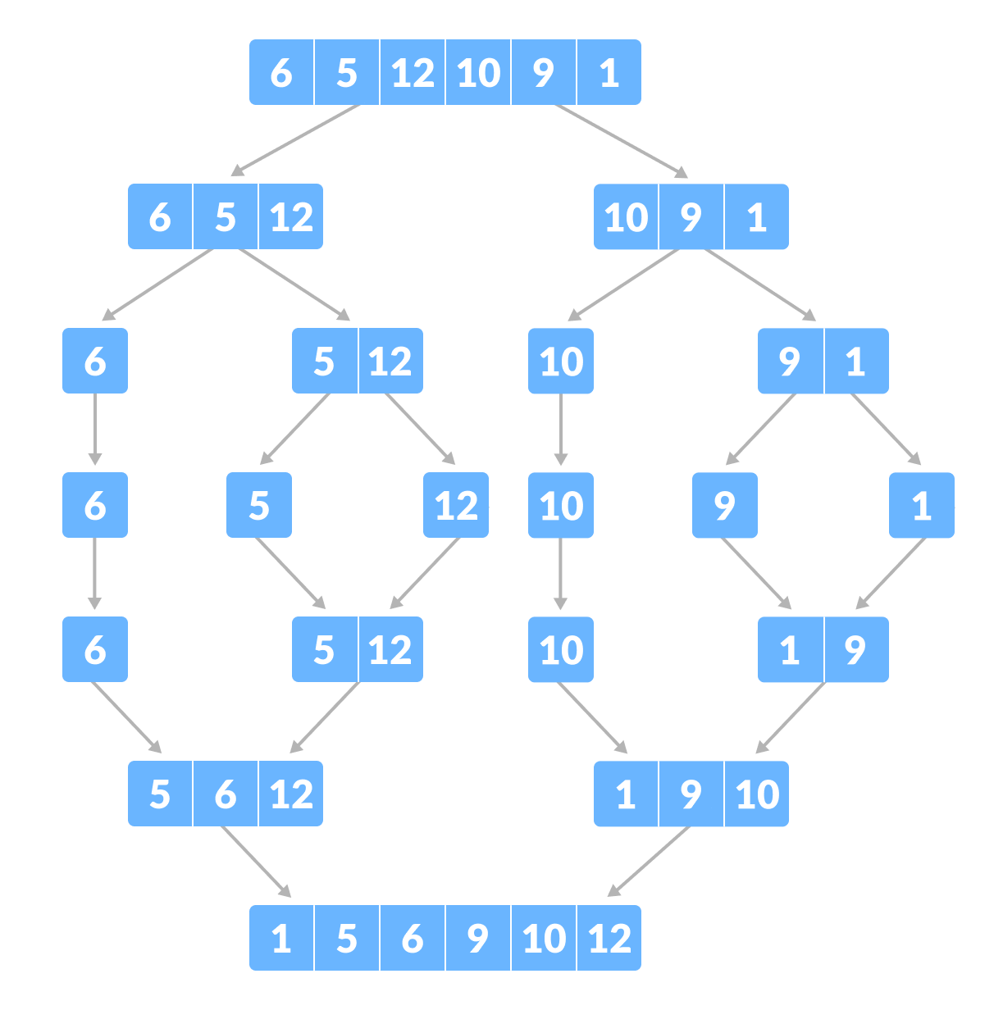
functional Programming
Is good for: divide and conquer algorithms
Code example: Merge sort algorithm: https://www.programiz.com/dsa/merge-sort
The Merge Sort algorithm combines Imperative and Functional
We’ll see how it works in detail on the Algorithms Topic. In short:
A = [6,5,12,10,9,1] p = 0 r = 5
==
1st call: mergeSort([6,5,12,10,9,1], 0, 5)
2nd call: mergeSort([6,5,12,10,9,1], 0, 2)
2nd call: mergeSort([6,5,12,10,9,1], 3, 5)
2nd call: mergeSort([6,5,12,10,9,1], 5, 5)
Slight inconsistence: should be [6,5] [12] instead of [6] [5,12]
2nd call: mergeSort([6,5,12,10,9,1], 3, 4)
Etc

Slide 16
functional Programming
Code example: Quick sort algorithm: https://www.geeksforgeeks.org/quick-sort/
15-minute break! Take some rest or solve exercises 4 and 5
Topic9_Python/Exercises/ProgrammingParadigms

Slide 17
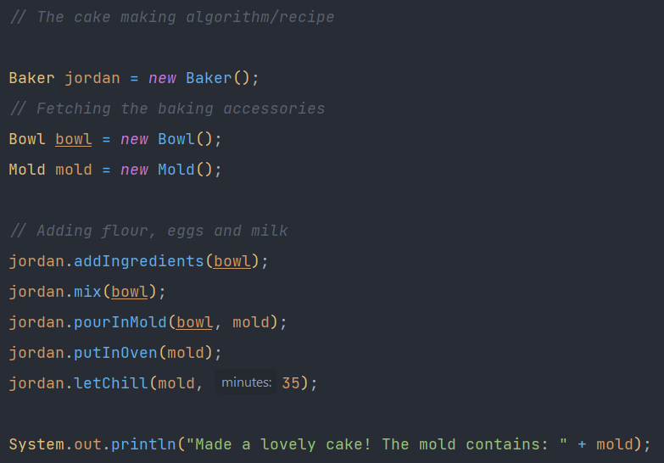
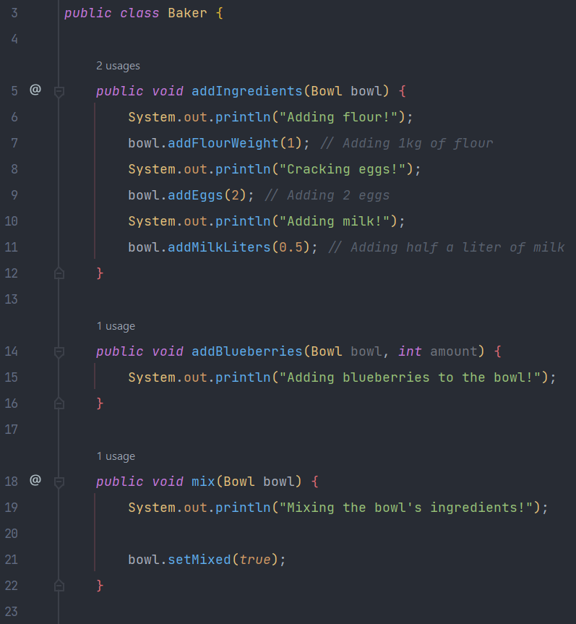
Object-oriented Programming (OOP)
Purpose: To separate concerns into entities (coded as objects)
Code example: Real life cake into code (in Java)
Main class:
Baker class:
It’s the baker’s responsibility to add ingredients, mix the bowl, pour the mixture to a mold, etc
Procedural
Programming

Slide 18
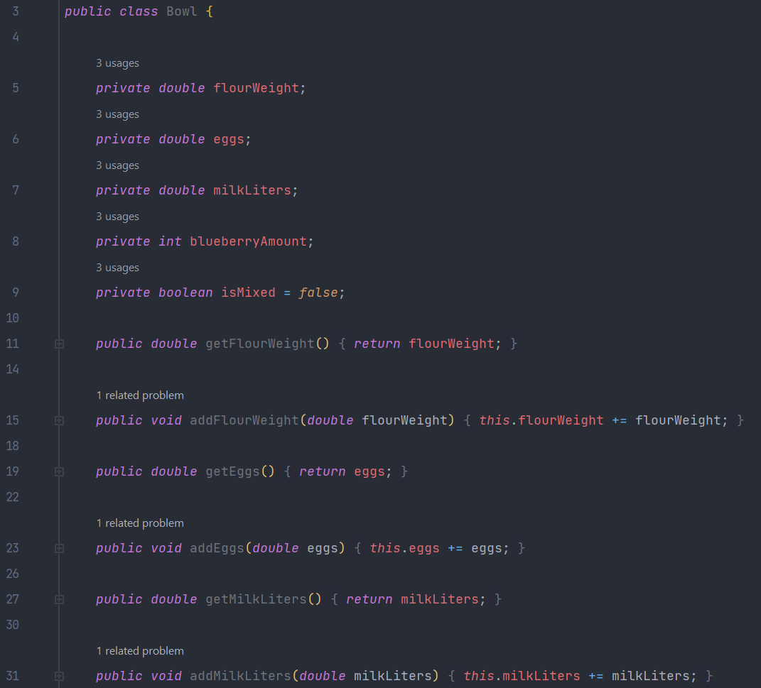
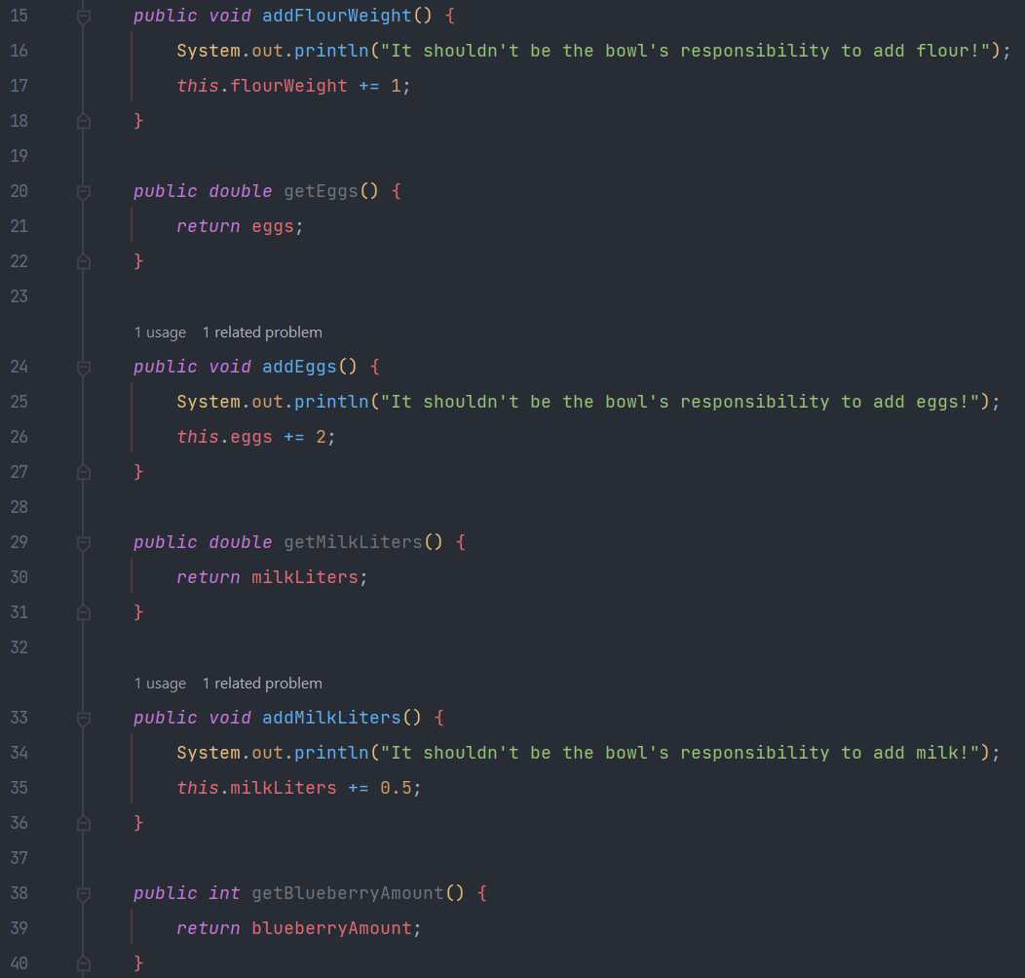

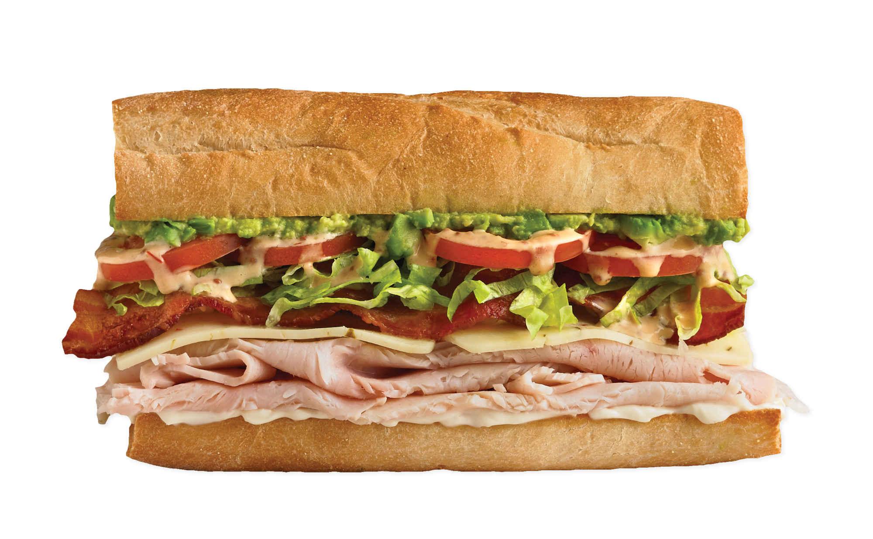
Object-oriented Programming (OOP)
Purpose: To separate concerns into entities (coded as objects)
Bad Code example: Real life cake into code (in Java)
Good Bowl class:
Bad Bowl class:
What if instead of Jordan making a cake, we want Gordon Ramsay to bake a cake? He’ll surely do things differently. But right now he can’t because the bowl is the boss.

Slide 19
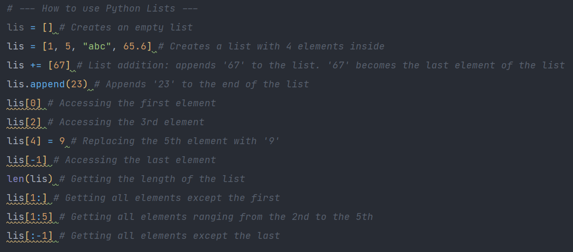
Object-oriented Programming (OOP)
Data Abstraction
Code example: Lists (in Python)
How do they work?
-Doesn’t matter.
What do they do?
-Store elements, access elements
How do I use them?
-Check their interface

Slide 20
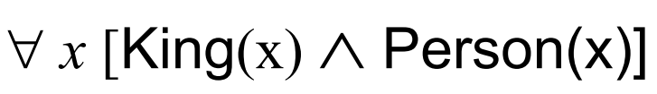

logic Programming
Logic clauses
Ex: First Order Logic
Facts and rules
Ex: First Order Logic
Facts: King(nexus) IsSoundFile(dotwav)
Rules:
Ex: Textual form
Facts: Socrates is a man
Rules: All men are mortal
By encoding these facts and rules in a logical program, the program would be able to infer the fact that Socrates is mortal (because he is a man)
Prolog (logical (and somewhat functional) programming language)
amy
alice
jennifer
Ex: parentOf(amy, alice). % This means that amy is the parent of alice
parentOf(alice, jennifer). % Facts are stated with a predicate followed by constants
grandparentOf(X, Y) :- parentOf(X, Z), parentOf(Z, Y). % X is the grandparent of Y if X is the parent of Z and Z is the parent of Y
Is amy the grandparent of jennifer? Yes, because this
grandparentOf(amy, jennifer) :- parentOf(amy, alice), parentOf(alice, jennifer).
can be inferred from the facts and rules previously established
Notes:
Programming languages that employ the Logic Paradigm allow programmers to write logic clauses, often written as Facts and Rules. Without explicitly saying that amy is the grandparent of jennifer, Prolog can infer this fact if we query it.

Slide 21
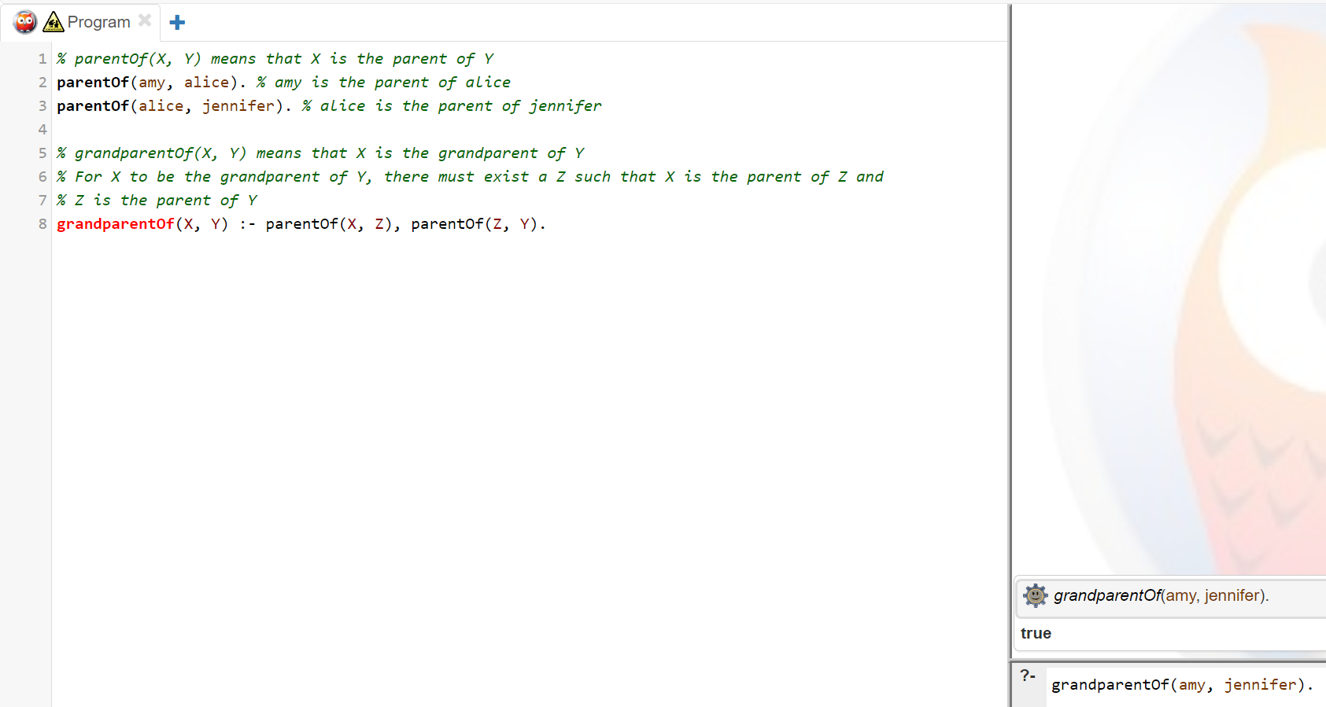
logic Programming
https://swish.swi-prolog.org/
Syntax:
UpperCamelCase:
Variable names
lowerCamelCase:
constants
predicates
records
predicate
constant
predicate
variable
variable
Facts and rules
Queries

Slide 22


logic Programming
Real life example: Figure out who can watch what movies
Facts:
Robert is 16.
Amy is 18.
The minimum age required to watch scary movies is 15.
The minimum age required to watch sexual movies is 18.
Rules:
A person can watch a movie if their age is equal or greater than the movie’s minimum required age.
Code example: (Prolog)
?- canWatch(amy, sexual).
true.
?- canWatch(robert, sexual).
false.
?- canWatch(X, scary).
X = robert;
X = amy.
% Facts:
age(robert, 16). %age of robert is 16
age(amy, 18).
minimumAge(scary, 15).
minimumAge(sexual, 18).
% Rules:
% canWatch(X, Y) means that X can watch movie Y
canWatch(X, Y) :- minimumAge(Y, MinAge), age(X, Age), Age >= MinAge.

Slide 23
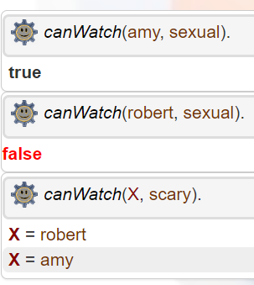

logic Programming

Slide 24
logic Programming
Topic9_Prolog/src/Exercises
Exercise 1 and 2.
https://swish.swi-prolog.org/

Slide 25
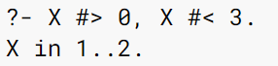
logic Programming
Constraint Programming (with a Prolog extension)
Applications: planning, scheduling, resource allocation, computer graphics, digital circuit design, fault diagnosis
Notes:
Variables are no longer bound by values. They are bound by restrictions.

Slide 26

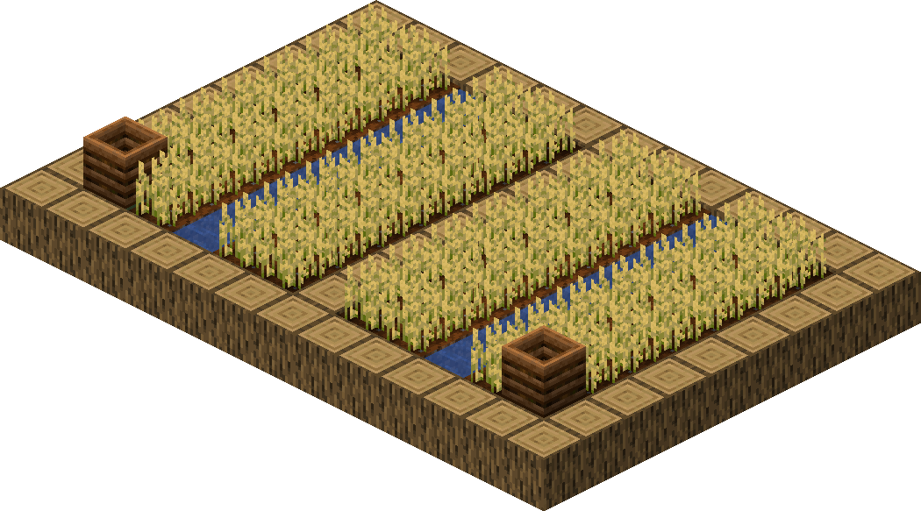

logic Programming
Constraint Programming (with a Prolog extension)
Code example: Fertilizers and fences for fields (Real life and Prolog)
1) How many Kilograms of fertilizer do I need to guarantee that each square meter gets at least 1 Kg?
I don’t want to spend too much money. I don’t want the land to receive too little fertilizer.
2) How many meters of fence do I need to fence off the entire field? I don’t want to spend too much money.
I don’t want to have holes in the fence perimeter.
Between 48m and 53m
Between 90m and 110m
Notes:
Lets say you are a farmer who wants figure out much fertilizer and meters of fence you. Your measurements of length and width are imprecise because you’re measuring with your feet

Slide 27
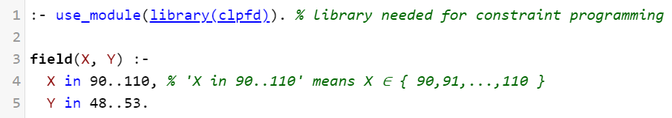
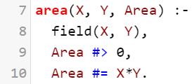
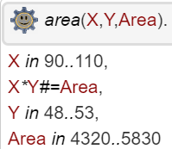
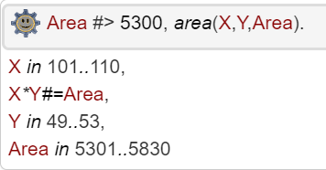
logic Programming
Constraint Programming (with a Prolog extension)
Code example: Fertilizers and fences for fields (Real life and Prolog)
1) How many Kilograms of fertilizer do I need to guarantee that each square meter gets at least 1 Kg?
I don’t want to spend too much money. I don’t want the land to receive too little fertilizer.
In other words, we want to know the area of the field
Notes:
Lets say you are a farmer who wants figure out much fertilizer and meters of fence you. Your measurements of length and width are imprecise because you’re measuring with your feet

Slide 28
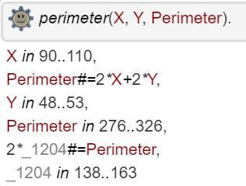
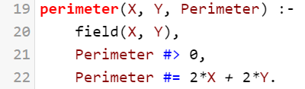
logic Programming
Constraint Programming (with a Prolog extension)
Code example: Fertilizers and fences for fields (Real life and Prolog)
2) How many meters of fence do I need to fence off the entire field? I don’t want to spend too much money.
I don’t want to have holes in the fence perimeter.
In other words, we want to know the perimeter of the field
Notes:
Lets say you are a farmer who wants figure out much fertilizer and meters of fence you. Your measurements of length and width are imprecise because you’re measuring with your feet

Slide 29
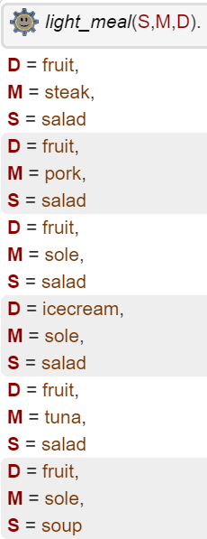
logic Programming
Constraint Programming (with a Prolog extension)
Code example: Planning our next meal (Prolog)
?- light_meal(S,M,D).
meat(steak,5).
meat(pork,7).
fish(sole,2).
fish(tuna,4).
dessert(fruit,2).
dessert(icecream,6).
main_course(M, I) :- meat(M, I).
main_course(M, I) :- fish(M, I).
starter(salad, 1).
starter(soup, 6).
light_meal(S,M,D) :-
I #> 0, J #> 0, K #> 0, I + J + K #=< 10,
starter(S, I), main_course(M, J), dessert(D, K).
I+J+K=0, I>0, J>0, K>0, starter(S,I), main_course(M,J), dessert(D,K).
S=salad, I=1, 1+J+K=0, J>0,K>0, 1>0, J>0, K>0 main_course(M,J), dessert(D,K).
.
.
.
S=salad, I=1, M=steak, J=5, D=fruit, K=2, 1+5+2=0, 1>0, 5>0, 2>0.

Slide 30
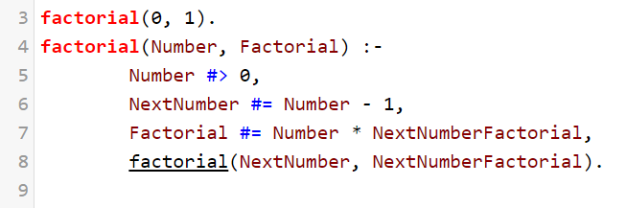
logic Programming
Topic9_Prolog/src/Exercises
Exercise 3.
https://swish.swi-prolog.org/
?

Slide 31
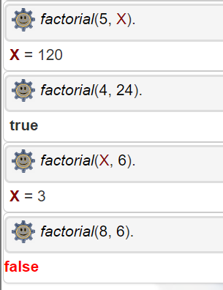
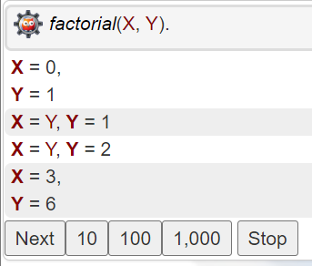
logic Programming
Predicate arguments
Can be both input and output arguments
in
out
out
out
in
in
out
in
I could go on asking for more factorials
in
in

Slide 32

logic Programming
Advantages:
Memory efficient
Can infer knowledge
Proximity with natural language
Inferring knowledge is built-in
Used in AI Knowledge-based systems
Easier to program puzzle solvers
Disadvantages:
Inferring can be very slow
Can get messy quickly
Very different from what we’re used to
Inferring may get stuck in an infinite depth search
No guarantees it finishes inferring
Hard to integrate with other paradigms

Slide 33

Programming Paradigms
Imperative
Procedural
Functional
Object-oriented
Logic

Slide 34


Slide 35



Applications
Code example: Heliomothra Glue Ability (Java)

Slide 36


Higher Order Programming

Slide 37


High order programming
An extension of Functional Programming
Functions are so important, that they can be stored in variables and can be passed as arguments
Variables may point to functions
Has lambda functions
100% integration with HOP
Easier to learn HOP
Variables cannot point to functions
Has lambda functions (they’re secretly objects)
90% integration with HOP
Weirder to learn HOP

Slide 38
High order programming
Motivation:
Topic9_Python/Examples/HigherOrderProgramming/HigherOrderProgrammingMotivation.py
Coding time!

Slide 39
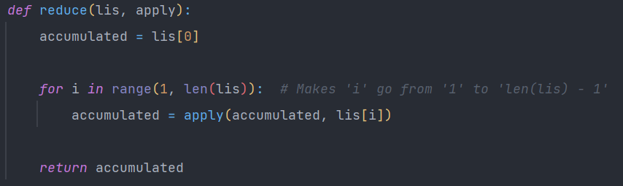
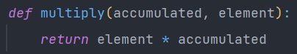
High order programming
Analyze what’s happening:
Java similarity
lis = [1,2,3,4] accumulated = 1 apply =
1st iteration: accumulated = multiply(1, 2)
accumulated = 2
2nd iteration: accumulated = multiply(2, 3)
accumulated = 6
3rd iteration: accumulated = multiply(6, 4)
accumulated = 24

Slide 40
High order programming
Topic9_Python/Exercises/HigherOrderProgramming
Exercise 6. Only solve the TODOs marked with “6.1”

Slide 41

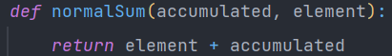
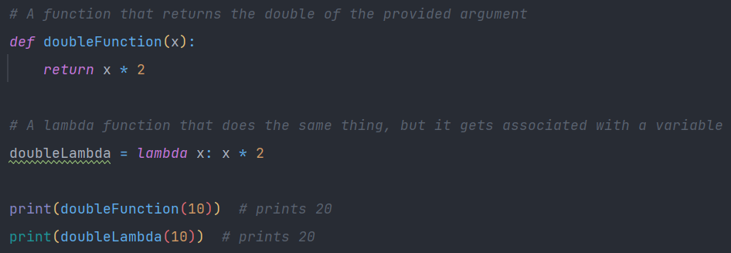
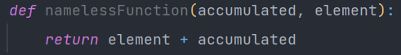
High order programming
Lambdas:
Most functional languages offer a shortcut for defining anonymous functions: Lambda
Points to a function similar to ‘normalSum’
function
body
Even though this is allowed, it’s bad practice
arguments

Slide 42
High order programming
Lambdas:
Topic9_Python/Examples/HigherOrderProgramming/HigherOrderProgrammingMotivation.py
Coding time!

Slide 43


High order programming
Topic9_Python/Exercises/HigherOrderProgramming
Exercise 6. Only solve the TODOs marked with “6.2”

Slide 44
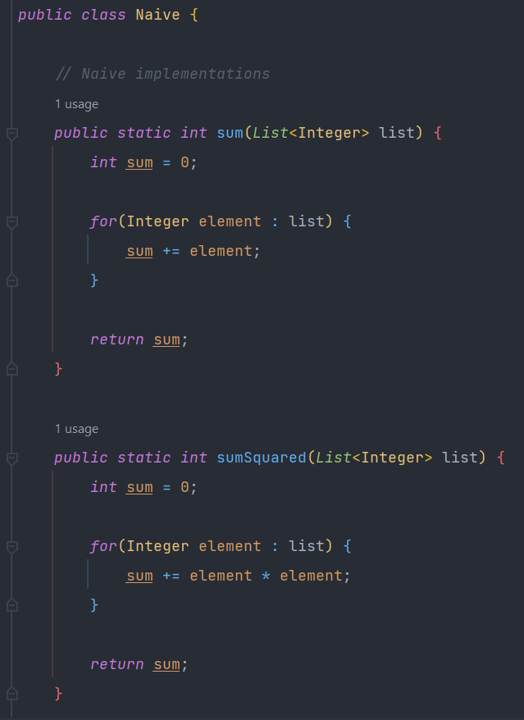
High order programming
Naive approach:

Slide 45
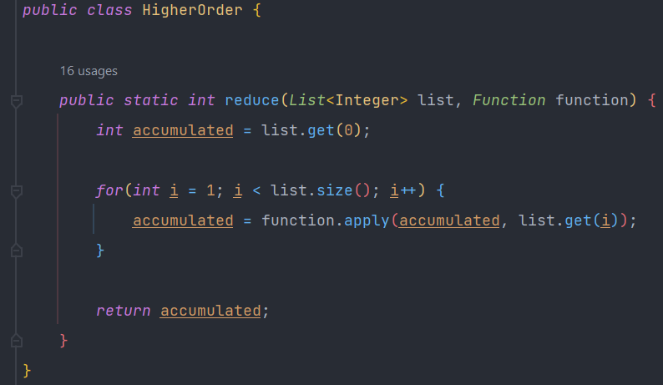
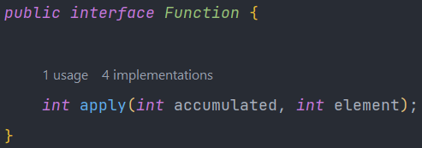
High order programming
Higher Order Approach 1:
Functions can’t be passed as arguments… How will we solve this?
But ‘apply’ isn’t implemented… What is ‘function.apply(…)’ doing?
This is the beauty of Procedural
Abstraction
All we need to know is how to use it: pass 2 arguments, receive the return value

Slide 46
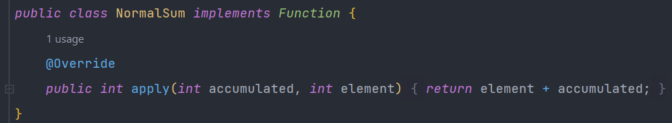
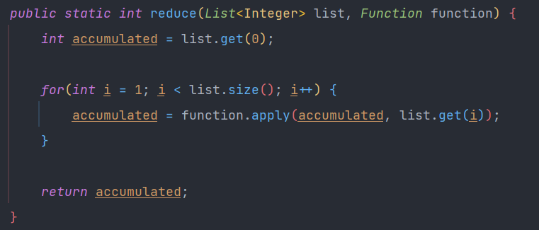
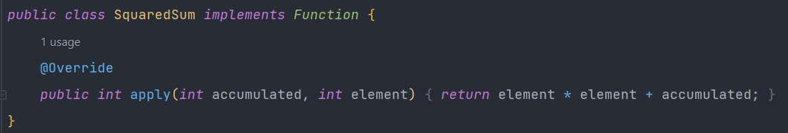
High order programming
Higher Order Approach 1: Inheritance
NormalSum instance passed as the ‘function’ argument

Slide 47
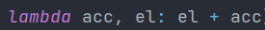
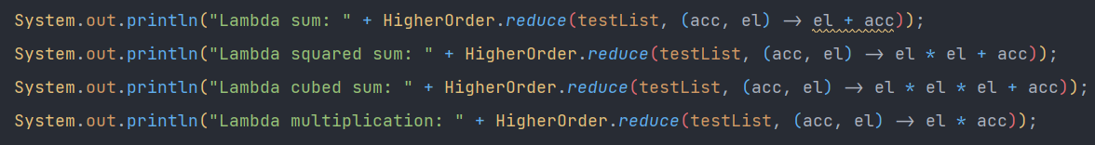
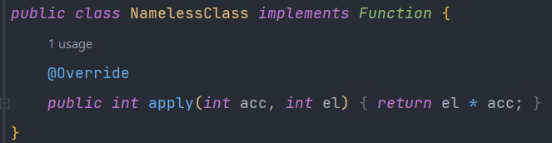
High order programming
Higher Order Approach 2: Lambda
Python version
Secretly creating instance of
function body
arguments
implicit

Slide 48
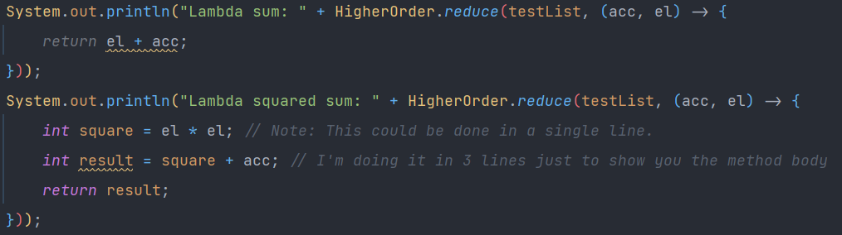
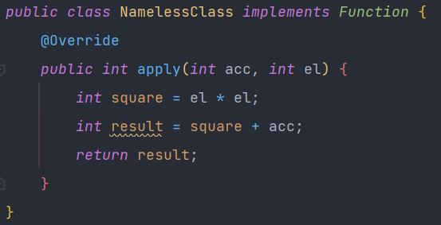
High order programming
Higher Order Approach 3: Explicit Lambda method body
Secretly creating instance of
arguments
function body
explicit

Slide 49
High order programming
Topic9_Java/Exercises/HigherOrderProgramming/Exercise1
Exercise 1. Solve TODOs 1.1, 1.2, 1.3 in their defined order
Consult Topic9_Java/Examples/HigherOrderProgramming/HOP_Approaches for help
TODO 1.1 is at the bottom of the exercise

Slide 50

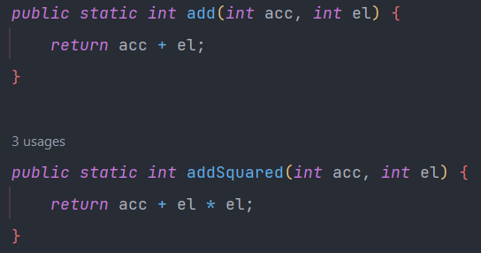
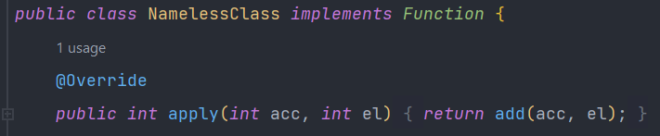
High order programming
Higher Order Approach 4: Lambda with method reference
Defined in the Main class:
Secretly creating instance of
function body
arguments

Slide 51




Slide 52
High order programming
Higher Order Approach 5: Lambda, direct method reference
Is exactly the same as this
Defined in the Main class:
Secretly creating instance of

Slide 53
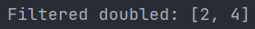
High order programming
gets result of ‘reduce’ operation
Higher Order Approach 6: Lambdas in Streams
Similar to this, but more general
remains unmodified
We must convert the stream back to a list
Stacking:

Slide 54


High order programming
Topic9_Java/Exercises/HigherOrderProgramming/Exercise1
Exercise 1. Solve TODOs 1.4, 1.5, 1.6, 1.7 in their defined order
Consult Topic9_Java/Examples/HigherOrderProgramming/HOP_Approaches for help

Slide 55



High order programming
Approach 7: When you can’t use lambdas
When can we not use them?
When creating an instance of an interface or abstract class, we must specify the missing behavior, AKA, its abstract methods. Lambdas only define 1 method.
Notes:
For us to be able to use lambdas in Java, the argument that we’re replacing with a lambda needs to have a single function

Slide 56


High order programming
Approach 7.1: When you can’t use lambdas- Default behavior
This way, we may use lambdas again
Notes:
For us to be able to use lambdas in Java, the argument that we’re replacing with a lambda needs to have a single function

Slide 57


High order programming
Approach 7.2: When you can’t use lambdas- Inheritance
inheriting
Notes:
For us to be able to use lambdas in Java, the argument that we’re replacing with a lambda needs to have a single function

Slide 58

High order programming
Approach 7.3: When you can’t use lambdas- Nameless classes
Secretly creating a NamelessClass with the following body:

Slide 59



High order programming
Utilities

Slide 60

High order programming
Utilities
Returns 1 if o1 is ‘greater’ than o2.
Returns 0 if o1 is ‘equal’ to o2.
Returns -1 if o1 is ‘less’ than o2.

Slide 61




High order programming
Sorting people by age
Approach 1: Inheritance
Specifying that ‘AgeComparator’ can only be used to compare people
To sort from oldest to newest, we could switch these lines

Slide 62

High order programming
Sorting people by age
Approach 2: Lambda with method reference

Slide 63


High order programming
Sorting people by age
Approach 3: Direct method reference

Slide 64
High order programming
Sorting people by name
Is there a problem in the sorted list?
Intuitively, ‘Jordan Dotwav’ should appear first since, even though the 1st name is the same, ‘Dotwav’ comes first than Ramsey when sorting by name

Slide 65
High order programming
Sorting people by name with a tie breaker: the last name
Sorting people by name with a tie breaker: the last name. Reversed
Sorting people by age without modifying original list

Slide 66


High order programming
Topic9_Java/Exercises/HigherOrderProgramming/Exercise2
Exercise 2

